Slide 1

Hotel Management System
A comprehensive software solution designed to streamline hotel operations, enhance guest experiences, and increase profitability.
done by:
Haritha.R (192210406)
Afrina begum.M(192210431)

Slide 2
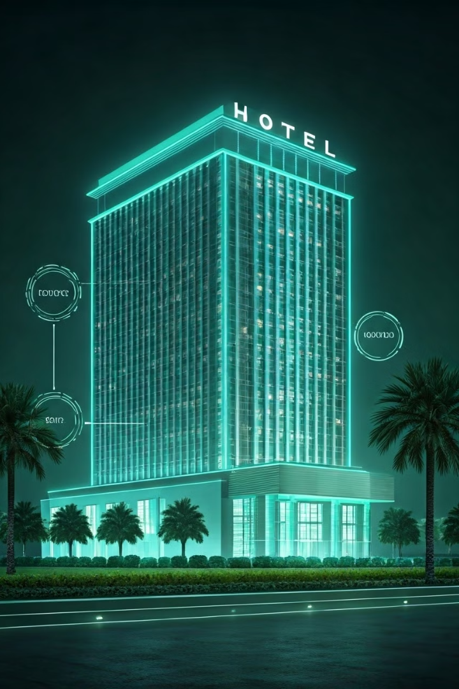
Overview
Our Hotel Management System (HMS) provides a centralized platform for managing all aspects of hotel operations, from reservations to guest services to financial reporting.
1
Increased Efficiency
2
Enhanced Guest Experience
Automate tasks, improve communication, and reduce manual errors, leading to streamlined operations.
Personalized services, seamless check-in/out, and 24/7 support contribute to a positive guest experience.
3
Data-Driven Insights
4
Scalability and Flexibility
Detailed reports and analytics provide valuable insights into hotel performance and identify areas for improvement.
Our system can be customized to meet the specific needs of any hotel, regardless of size or type.

Slide 3
Key Features
Our Hotel Management System offers a comprehensive suite of features designed to optimize hotel operations.
Reservations Management
Guest Profiles
Housekeeping and Maintenance
Online booking, room availability tracking, reservation confirmations, and guest communication.
Centralized database for guest information, preferences, and past stays, enabling personalized services.
Room status tracking, maintenance requests, and automated cleaning schedules for efficient operations.

Slide 4

Reservation Management
Our system simplifies the reservation process, allowing guests to book online, manage their reservations, and communicate with the hotel.
1
Online Booking Engine
Guests can book rooms directly through the hotel website, with real-time availability updates.
2
Reservation Management
Hotel staff can easily manage reservations, assign rooms, track guest details, and manage cancellations.
3
Guest Communication
Automated confirmation emails, pre-arrival questionnaires, and guest communication tools enhance guest experience.

Slide 5
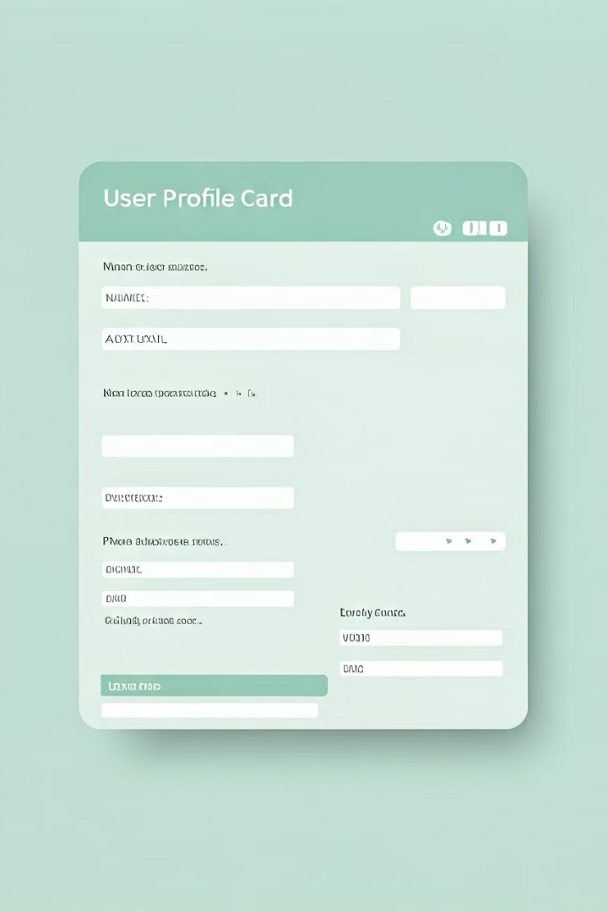
Guest Profiles
Create detailed guest profiles that capture essential information, preferences, and past stay history for personalized service.
Personalized Recommendations
Loyalty Programs
Track guest loyalty points, provide exclusive offers, and foster repeat business through personalized rewards.
Offer tailored recommendations based on guest preferences, such as room upgrades, dining suggestions, and activity options.
Guest History
Access past stay details, including guest requests, preferences, and feedback for improved service and future planning.

Slide 6
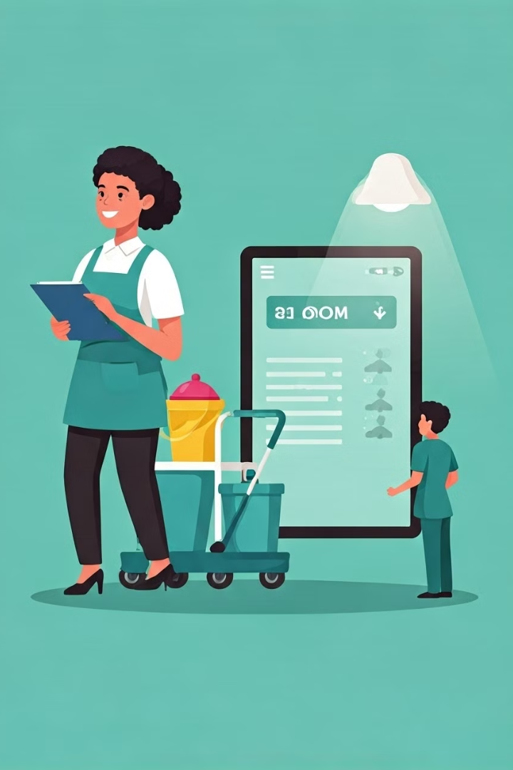



Housekeeping and Maintenance
Manage housekeeping tasks, track room status, and streamline maintenance requests for efficient hotel operations.
Room Status Tracking
Real-time updates on room status, such as clean, dirty, occupied, or out of order.
Maintenance Request Management
Guests can easily submit maintenance requests through the system, and staff can track and manage requests efficiently.
Automated Cleaning Schedules
Optimize cleaning schedules based on room occupancy and guest preferences.

Slide 7
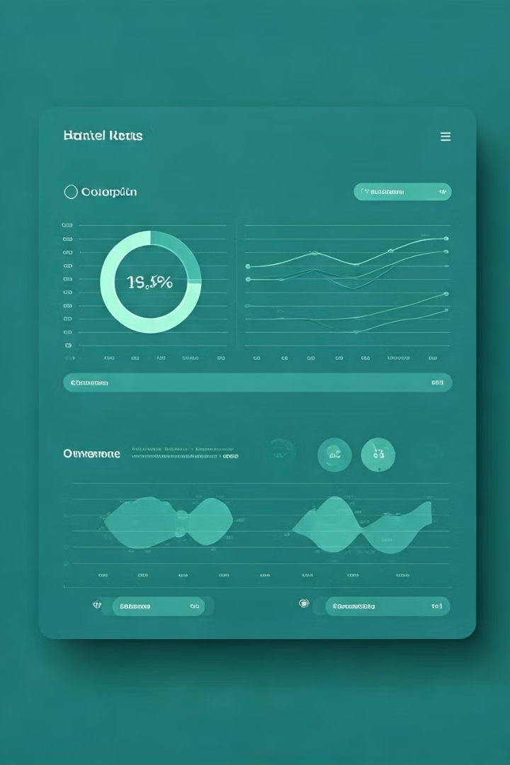
Reporting and Analytics
Gain valuable insights into hotel performance with comprehensive reporting and analytics tools.
Occupancy Rates
Track daily, weekly, and monthly occupancy trends to optimize pricing and marketing strategies.
Revenue
Analyze revenue streams, identify growth opportunities, and track profitability.
Guest Satisfaction
Monitor guest feedback, identify areas for improvement, and enhance overall guest experience.
Operational Efficiency
Track staff productivity, analyze housekeeping and maintenance performance, and identify areas for optimization.

Slide 8
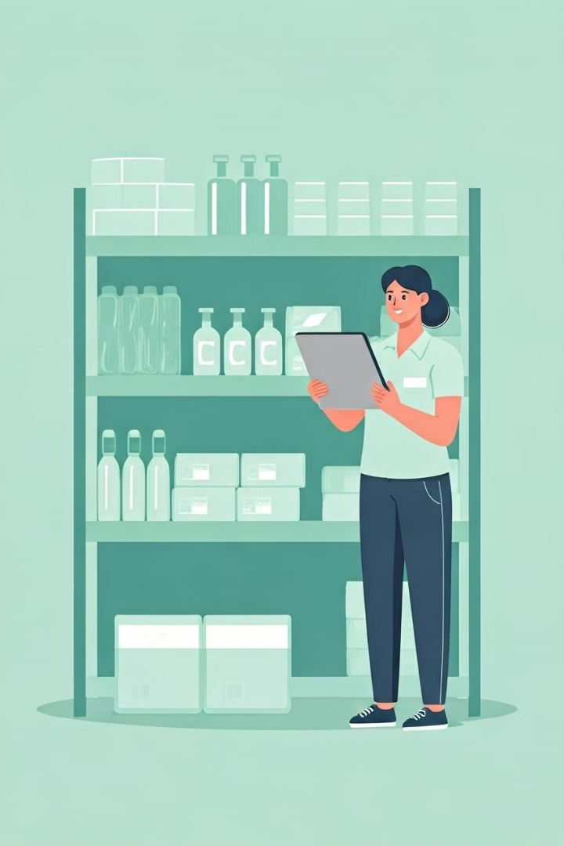




Inventory Management
Manage hotel inventory effectively, from amenities to linens to food and beverage supplies.
Real-Time Tracking
Automated Ordering
Track inventory levels in real-time, ensuring sufficient stock and preventing shortages.
Set reorder points and trigger automated orders when inventory levels reach a predetermined threshold.
Supplier Management
Inventory Audits
Manage relationships with suppliers, track purchase orders, and negotiate favorable pricing.
Regularly audit inventory levels to ensure accuracy and identify potential discrepancies.

Slide 9



Staff Scheduling
Streamline staff scheduling, optimize labor costs, and improve staff management with our efficient scheduling tools.
Shift Scheduling
Team Management
Real-Time Notifications
Create and manage employee shifts, assign roles, and ensure adequate staff coverage.
Coordinate schedules across departments and ensure efficient communication among staff members.
Alert staff members about schedule changes, time-off requests, and important announcements.

Slide 10
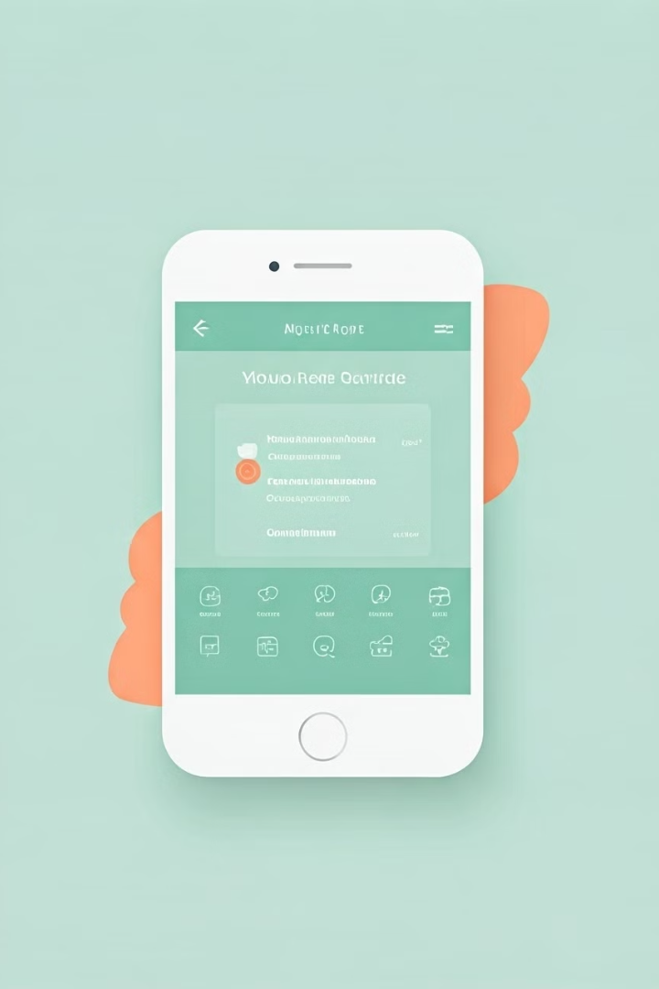
Mobile App Integration
Offer a seamless mobile experience with integrated mobile app features for enhanced guest interaction and operational efficiency.
1
Mobile Check-In/Out
2
Concierge Services
Guests can check-in and out directly through the mobile app, eliminating queues and streamlining the process.
Guests can request services like room service, wake-up calls, and local recommendations through the app.
3
Guest Feedback
4
Mobile Payment
Guests can provide real-time feedback on their stay, enabling the hotel to address issues promptly and improve services.
Guests can make payments securely through the app, simplifying the checkout process and providing convenient payment options.

